Slide 1






U.S. Airline On-Time Performance Database
DATA 201 DBMS Group Project
Group 8, members: Charishma, Swathi, Priyanka, William

Slide 2

Dataset Introduction
Source: U.S. Department of Transportation, Bureau of Transportation Statistics
Dataset: Reporting Carrier On-Time Performance
Period: January–June 2026
Monthly files combined: 6
Total flight records: 3.4+ Million
Raw attributes: 61
Each row represents a reported flight

Slide 3

Why We Chose This Dataset?
This dataset was selected because it :
Represents a real-world transportation system.
Has more than 3.4 million flight level data entries.
Facilitates comparison among airlines, airports, routes, and months.
Provides details of operation as well as performance measurements.
Requires data cleaning and normalization before database implementation.
Can be used to formulate both simple and complex SQL queries.
Questions our database will answer :
Which airlines have the best departure and arrival on-time performance?
Which airports and routes experience the most delays?
What are the most common causes of delays?
How do cancellations and diversions vary by airline and month?

Slide 4
Dataset Complexity
Data Preparation and Cleaning Needs
Combine six monthly files with consistent column structures.
Normalize to 1NF , 2NF, 3NF.
We have also downloaded the parent lookup tables for mapping .
Convert blank values to NULL rather than treating them as zero.
Keep negative delays as negative because they show early departures/arrivals.
Convert FL_DATE, which includes a time portion, into a proper date value.
Standardize scheduled time fields such as 0600 and 0915.
Treat CANCELLED and DIVERTED fields as Boolean fields.
Handle diversion-summary fields, which may be NULL for non-diverted flights.

Slide 5
Columns Used for the Database
Data area | Examples | Purpose
Date | FL_DATE, YEAR, QUARTER, MONTH, DAY_OF_MONTH, DAY_OF_WEEK | Monthly and date analysis
Airline | OP_UNIQUE_CARRIER, OP_CARRIER_AIRLINE_ID | Airline comparisons
Airport | ORIGIN, DEST, airport IDs, cities, states | Airport and route analysis
Route | Origin airport, destination airport, DISTANCE | Route-distance analysis
Flight | Generated FlightID, flight number, tail number | Flight identification
Performance | Scheduled/actual times, delays, taxi times, elapsed times | On-time performance
Status | CANCELLED, CANCELLATION_CODE, DIVERTED | Cancellation and diversion analysis
Note: The table shows representative columns by data area.
All 61 source columns are preserved in the staging dataset and mapped to normalized tables.

Slide 6
Schema Design & Database Setup
From raw flight records to a normalized relational database
ER model and relationship design
Relational schema mapping and key structure
Normalization up to 3NF
MySQL staging import and validation
Current-status: Six monthly files imported
Staging records: 3.4+Million records

Slide 7
Initial ER Diagram :
The ER model separates :
Flight operations
Airlines, airports, and routes
Dates and performance measures
Delays, cancellations, and diversions
The model shows how these entities connect through relationship cardinalities.

Slide 8
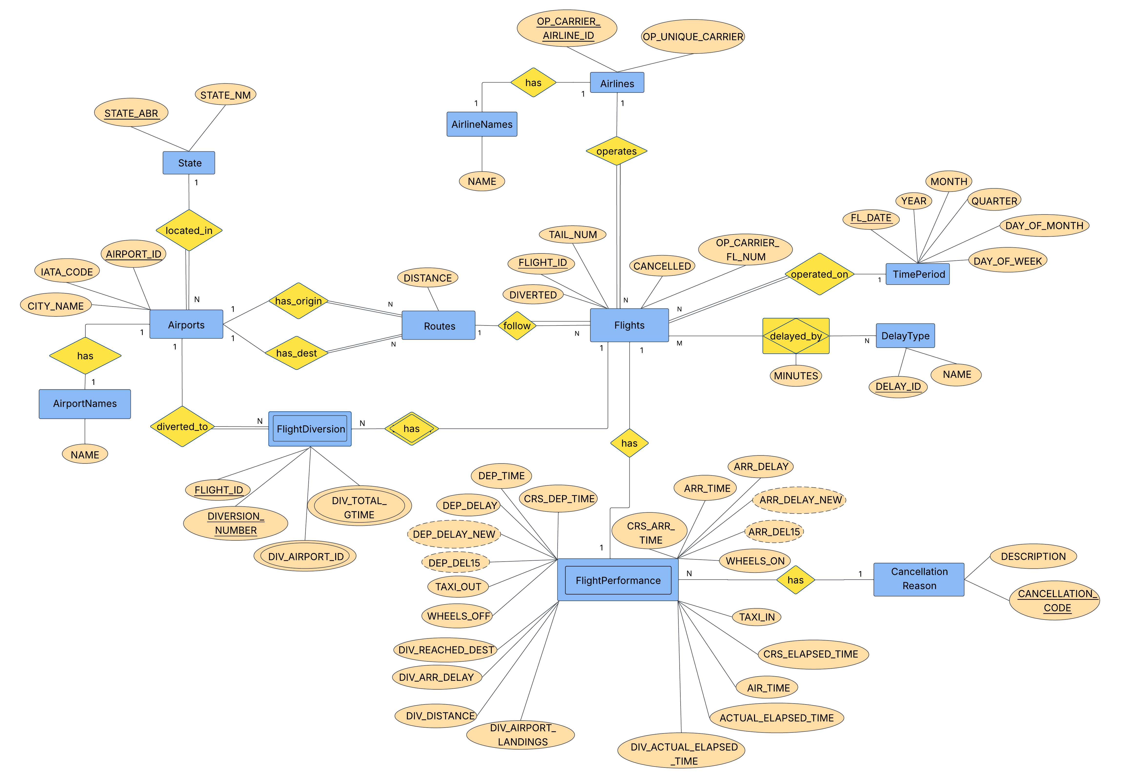
Initial ER/EER Diagram:

Slide 9
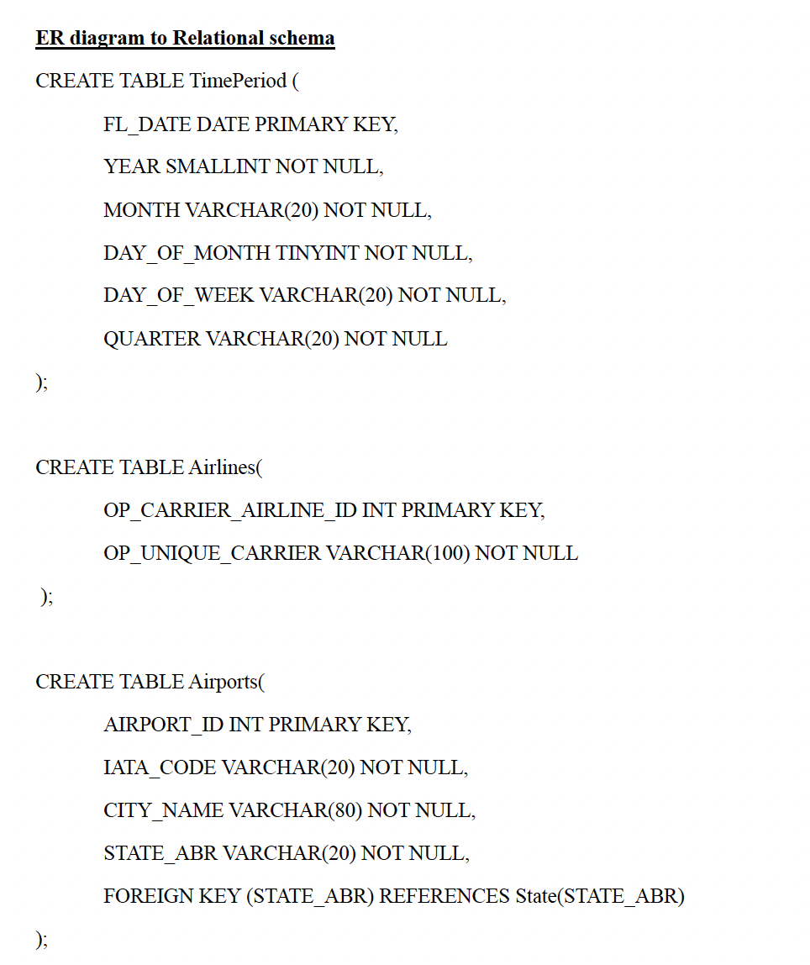
Relational Schema Mapping:
TimePeriod
State
Airlines
AirlineNames
Airports
AirportNames
Routes
Flights
FlightPerformance
DelayType
FlightDelay
CancellationReason
FlightDiversion
The raw staging table will be transformed into these normalized tables.
Generated identifiers such as FLIGHT_ID and ROUTE_ID will be added during the relational mapping process.

Slide 10
Keys and Relationship Justification
Table | Primary key
TimePeriod | FL_DATE
State | STATE_ABR
Airlines | OP_CARRIER_AIRLINE_ID
Airports | AIRPORT_ID
Routes | ROUTE_ID
Flights | FLIGHT_ID
FlightPerformance | FLIGHT_ID
FlightDelay | FLIGHT_ID + DELAY_ID
FlightDiversion | FLIGHT_ID + DIVERSION_NUMBER
Primary keys uniquely identify records.
Foreign keys connect related tables in the relational schema.

Slide 11
Functional Dependencies:
Airline
OP_CARRIER_AIRLINE_ID → OP_UNIQUE_CARRIER
Airport
AIRPORT_ID → IATA_CODE, CITY_NAME, STATE_ABR
State
From state lookup file: STATE_ABR → STATE_NM
Time Period
FL_DATE → YEAR, QUARTER, MONTH, DAY_OF_MONTH, DAY_OF_WEEK
Cancellation
From cancellation lookup file: CANCELLATION_CODE → DESCRIPTION
Delay Type
DELAY_ID → NAME
Route
ROUTE_ID → ORIGIN_AIRPORT_ID, DEST_AIRPORT_ID, DISTANCE
Diversion Details
(FLIGHT_ID, DIVERSION_NUMBER) → DIV_AIRPORT_ID, DIV_TOTAL_GTIME
These dependencies guided the decomposition of the raw BTS dataset into normalized relations.

Slide 12
Normalization Through 3NF
Raw BTS Dataset → 61 raw attributes
1NF — Atomic values → Repeating groups of delay and diversion groups separated.
Flight Delay • Flight Diversion
2NF — Partial dependencies removed → separated entities with their own keys.
Airlines • Airports • Routes • Time Period • Flights • Flight Performance
3NF — Transitive dependencies removed → Lookup entities separated.
State Names • Airline Names • Airport Names • Cancellation Reason • Delay Type
Final Schema
13 related tables

Slide 13
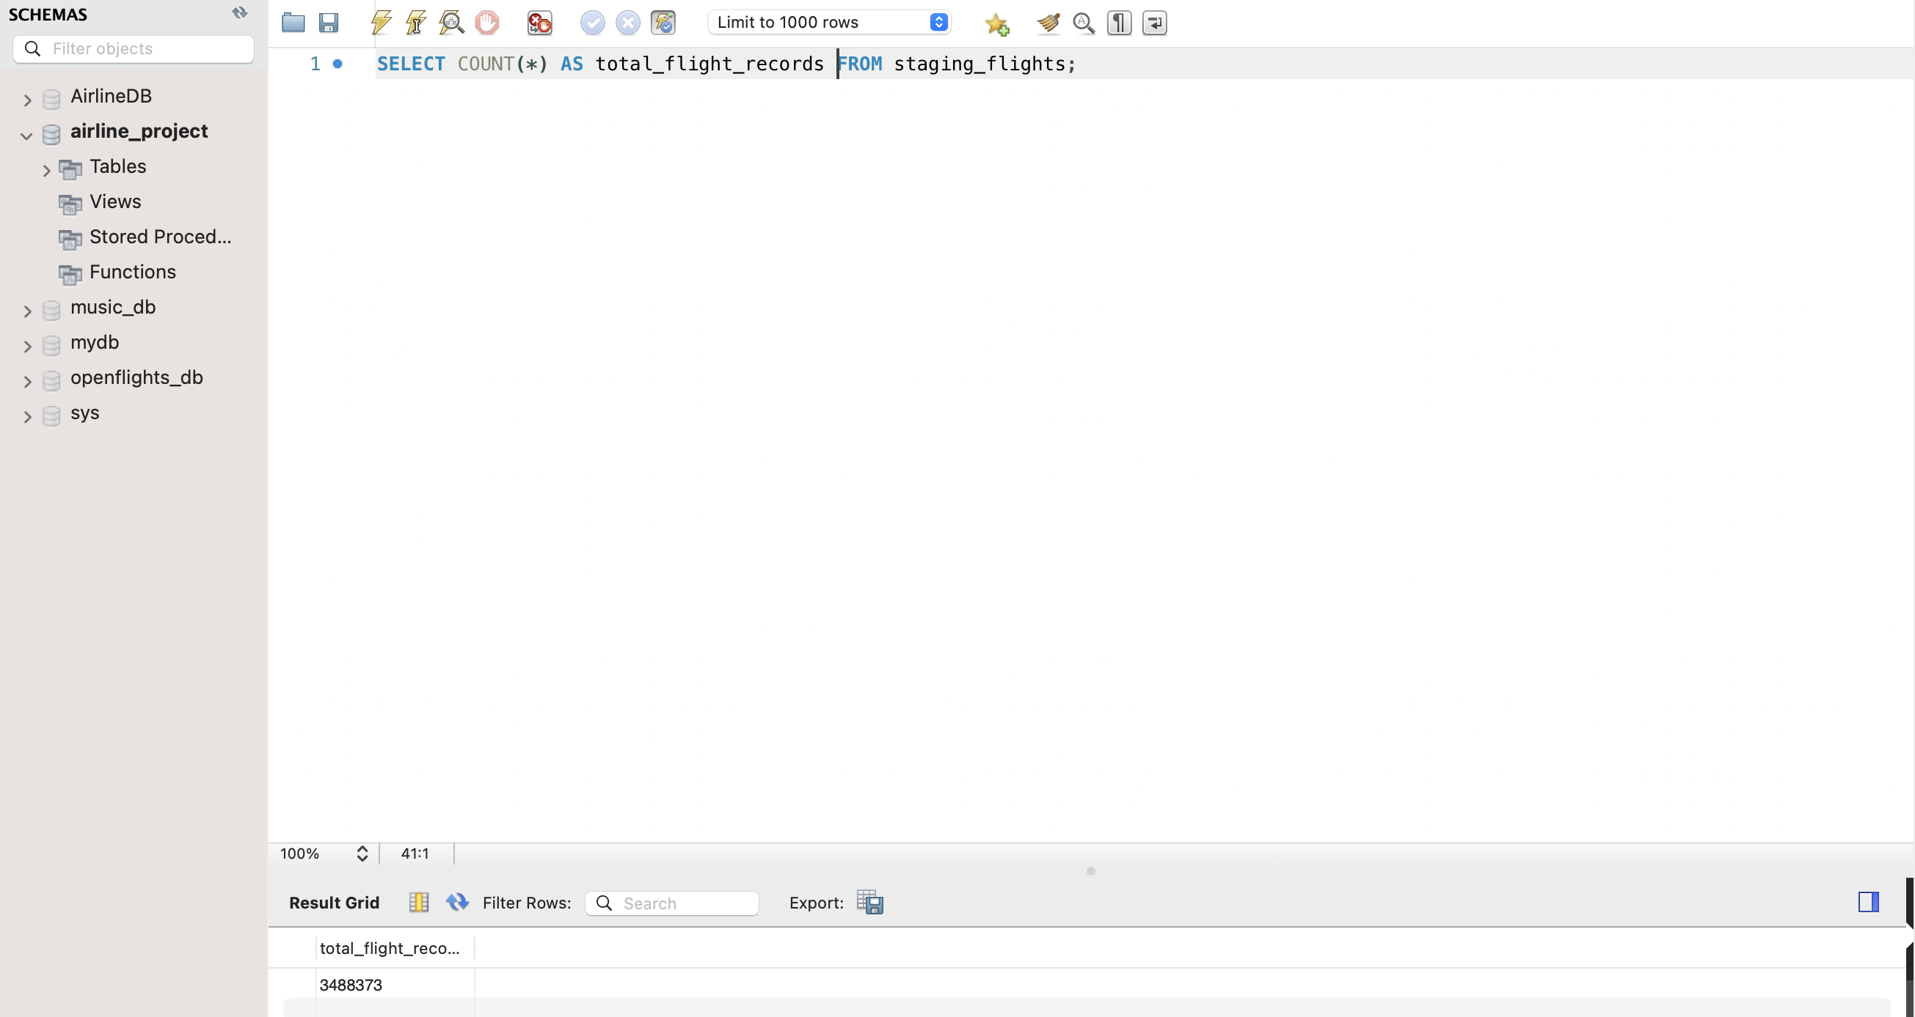
Initial SQL Exploration :
Confirmed that all six-monthly files were imported
Verified 3,488,373 total records
Checked monthly row counts
Examined delays, cancellations, and diversions
Confirmed that the dataset is suitable for analysis

Slide 14
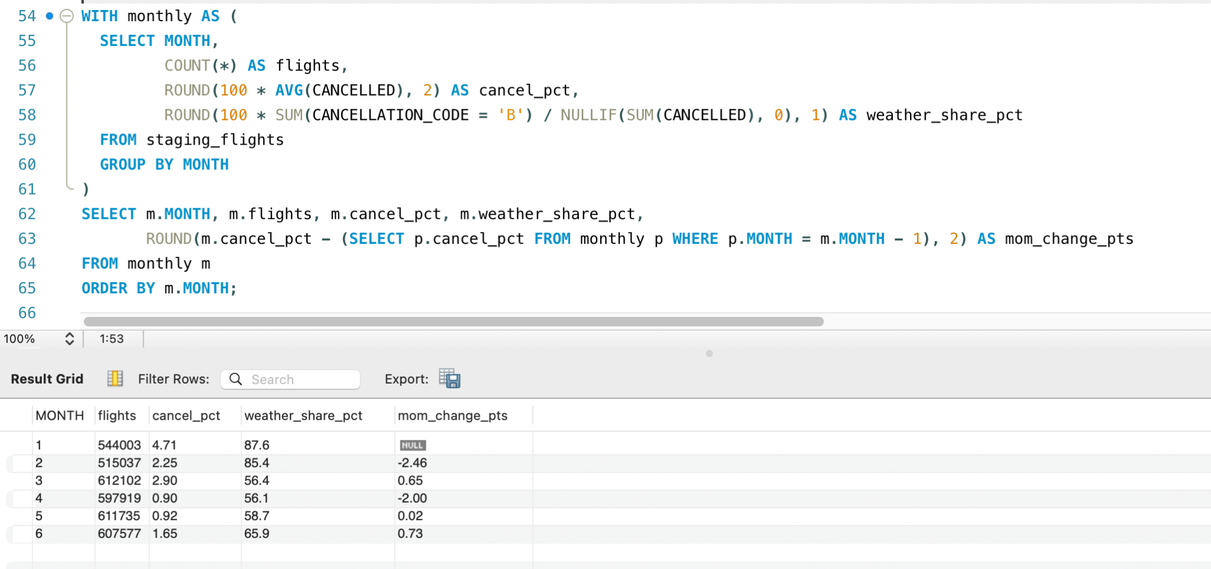
Basic and Advanced SQL Queries
Swathi
Business statement : Track how the cancellation rate changes from one month to the next, and how much of it is weather-driven, to separate seasonal shocks from operational problems.

Slide 15
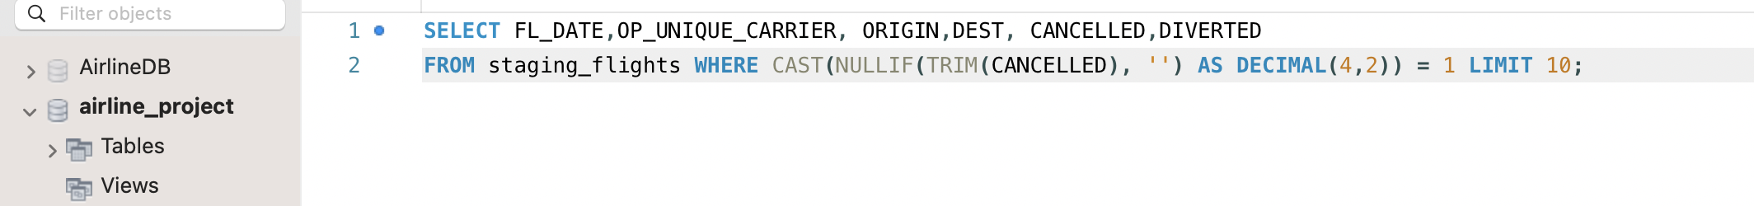
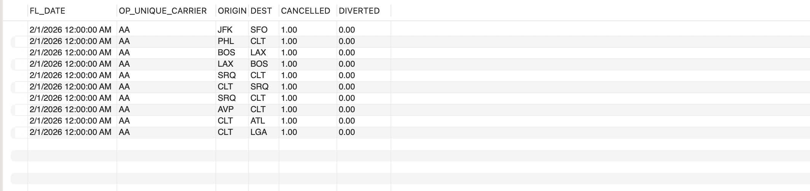
Basic and Advanced SQL Queries
Priyanka
Identifying Cancelled Flights
Which flights were cancelled, and what were their date, airline, origin, destination, and diversion status?

Slide 16
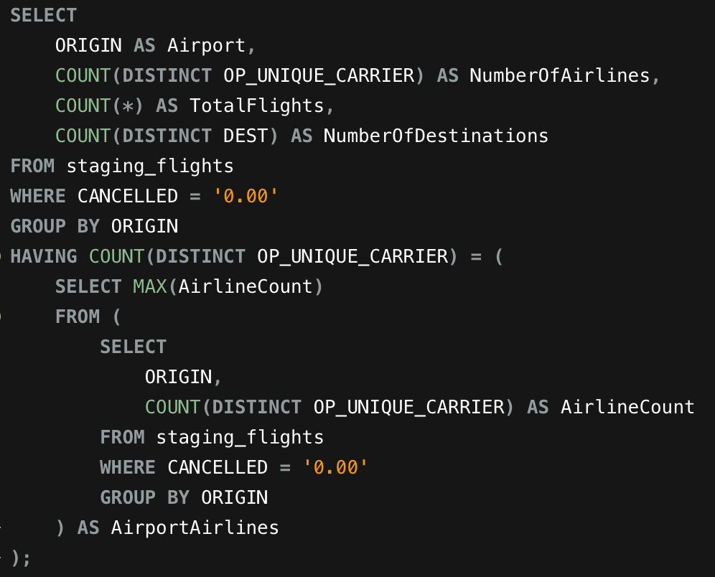
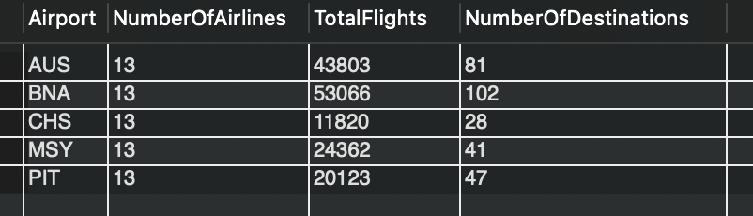
Basic and Advanced SQL Queries
Charishma
Question: Which origin airports are served by the greatest number of different airlines, and how many flights and destinations did they have?

Slide 17
Challenges & Next Steps
Challenges so far:
Mapping BTS raw column names to normalized table columns
Handling multiple raw files with 61 columns
Importing and processing more than 3.4 million records
Checking primary and foreign key relations
Maintaining query efficiency with large data set
Planned improvements for the final project:
Design and test advanced SQL queries
Completing and validating the 13-table normalized DB
Creating dashboards and visualizations
Finalize findings and project documentation for final presentation

Slide 18
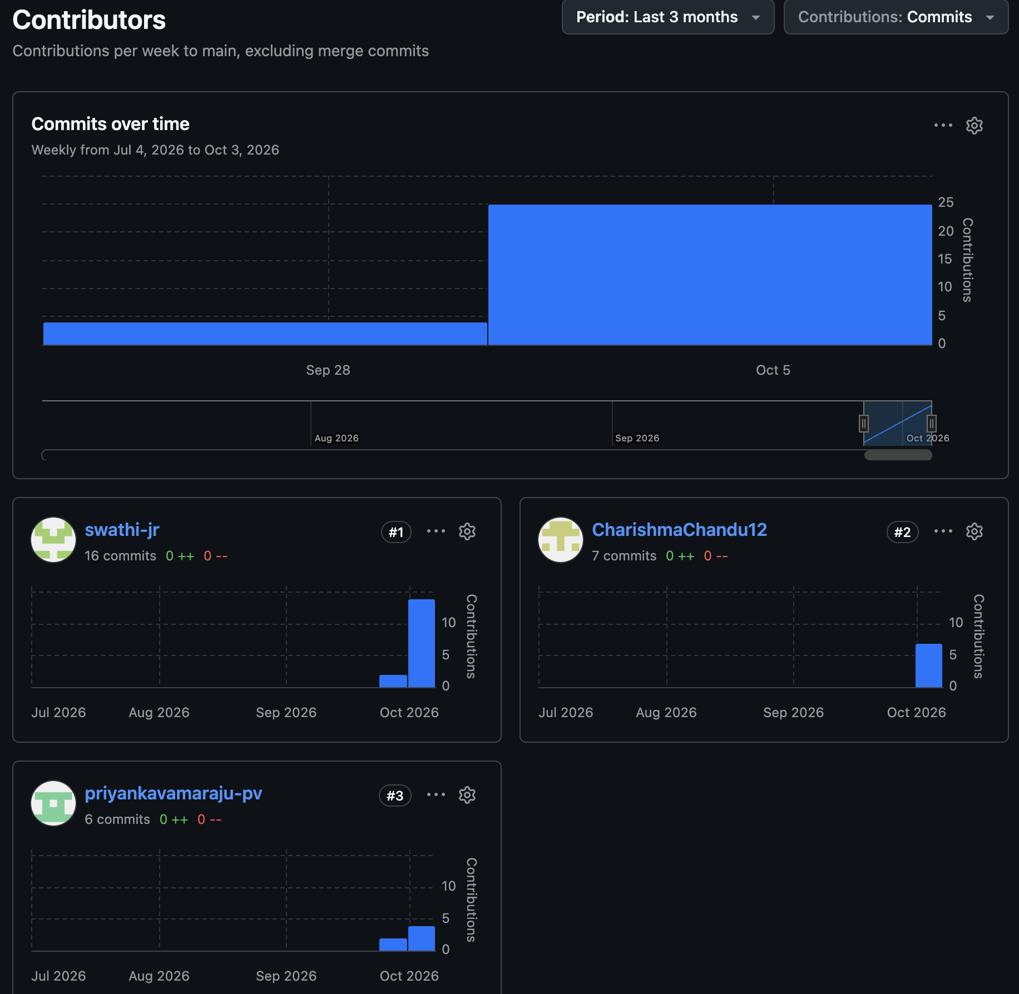

Individual Contribution (GitHub):
Link: https://github.com/CharishmaChandu12/DBMS-Project

Slide 19


